Slide 1

Sprocket Central Pty Ltd
Data analytics approach
[Youssef Hussein Ahmed]

Slide 2
Agenda
Introduction
Data Exploration
Model Development
Interpretation

Slide 3
Introduction
What is/are the main feature(s) of interest in your dataset?
For Customer dataset:
gender
past_3_years_bike_related_purchases
job_industry_category
wealth_segment
deceased_indicator
owns_car
age
state
property_valuation
For Transactions dataset:
brand
product_line
product_class
product_size
list_price
standard_cost

Slide 4
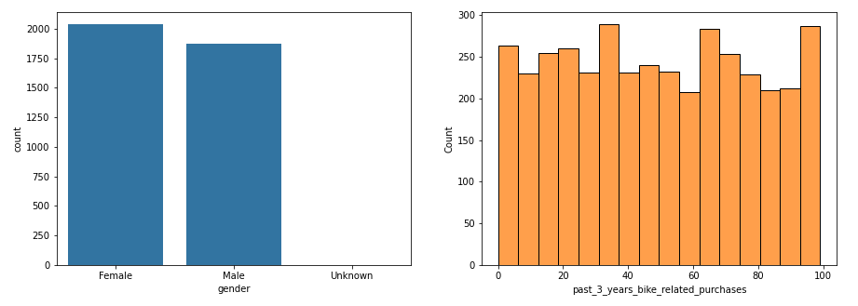
Data Exploration
Insightful explorations during this module is found to be Univariant
Exploring gender and past_3_years_bike_related_purchases

Slide 5
Data Exploration
Explorations' findings
gender exploration shows that gender has no critical effect on customers' number. Although the number of female customers are slightly greater than male customer.
past_3_years_bike related purchases exploration shows that customers purchases during the past 3 years are varying according to some unknown pattern that we hope to discover.

Slide 6
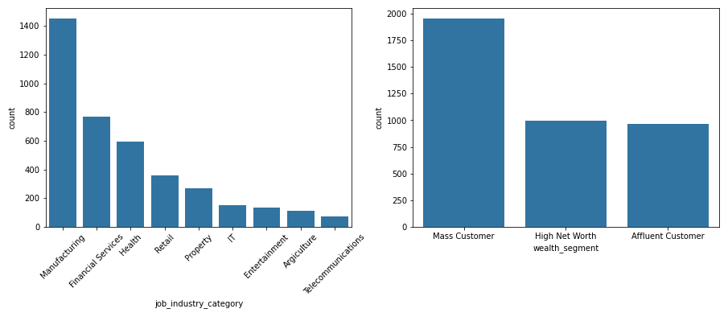
Data Exploration
Exploring job_industry_category and wealth_segment

Slide 7
Data Exploration
Explorations' findings
job_industry_category exploration shows that:
The great proportion of customers (more than 1400 customer) are working in Manufacturing.
The second highest proportion of customers (less than 800 customer) are working in Financial Services.
The least proportion of customers are working in Telecommunications.
wealth_segment exploration shows that:
Nearly more than half customers are Mass Customers.
The proportion of High-Net-Worth customers and Affluent Customers are nearly the same.

Slide 8
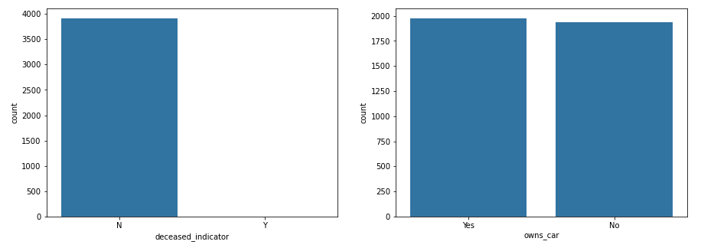
Data Exploration
Exploring deceased_indicator and owns_car

Slide 9
Data Exploration
Explorations' findings
deceased_indicator exploration naturally shows that nearly all customers during the past 3 years are not dead by now.
As not expected, owns_car exploration shows that the proportion of customers who own cars are nearly same as the customers who don't.

Slide 10
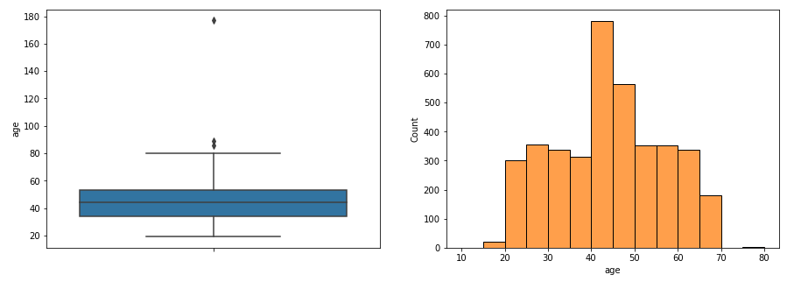
Data Exploration
Exploring age
age exploration shows that the great proportion of customers have ages between 40 to 50 years old.

Slide 11
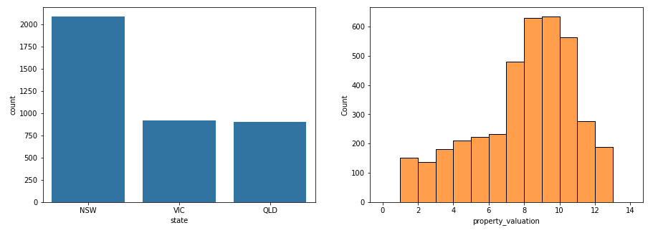
Data Exploration
Exploring state and property_valuation

Slide 12
Data Exploration
Explorations' findings
state exploration shows that the great proportion of customers (more than 2000) are from NSW.
property_valuation exploration shows that the great proportion of customers have property property_valuation value between 7 to 12.

Slide 13
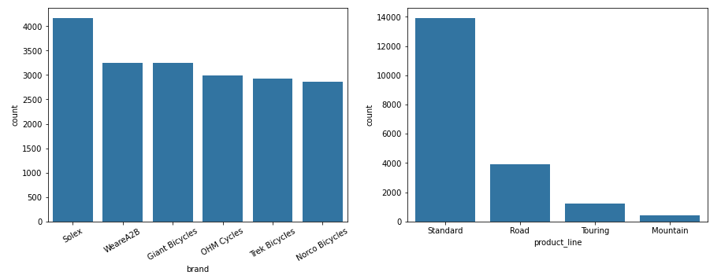
Data Exploration
Exploring brand and product_line

Slide 14
Data Exploration
Explorations' findings
brand exploration shows that Solex products have the greatest number of transactions, while rest of brands have convergent numbers of transactions.
product_line exploration shows that Standard product line products have the greatest proportion of transactions.

Slide 15
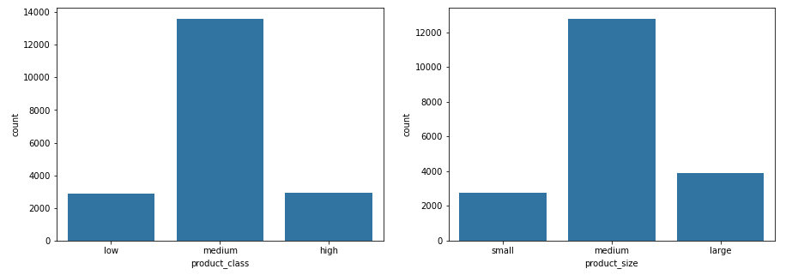
Data Exploration
Exploring product_class and product_size
product_class and product_size explorations show that products with medium sizes and classes have the greatest proportion of transactions.

Slide 16
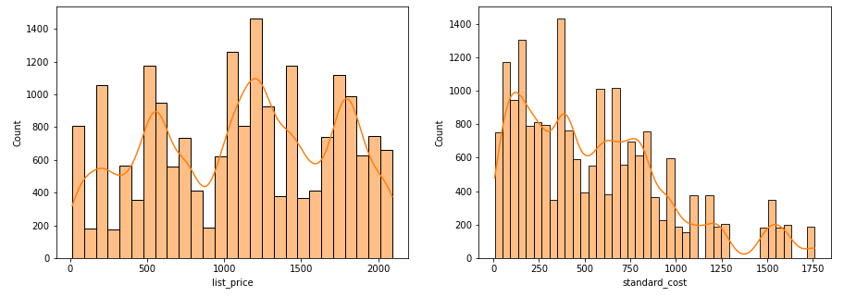
Data Exploration
Exploring list_price and standard_cost

Slide 17
Data Exploration
Explorations' findings
list_price exploration shows that products prices have no critical effect on transactions.
standard_cost exploration shows that products that have the greatest proportion of transactions have low standard cost and whenever the standard_cost increase the number of transactions decrease.

Slide 18
Model Development
Using the previous analysis, a model can be developed as following:
job_industry_category
wealth_segment
age
number_of_bike_related_purchases_next_year
state
Model
property_valuation
product_line
product_class
standard_cost

Slide 19
Interpretation
We can interpret the results of these analysis as following:
Sprocket Central Pty Ltd company should give more interest to customers who:
Works in Manufacturing.
Their wealth segment is Mass Customers.
Their ages are between 40 to 50 years old.
Lives in NWS state.
Property value are between 7 to 12.
Sprocket Central Pty Ltd company should make offers on products that:
Manufactured through standard product line.
Their classes and sizes are medium.
Their standard cost are low.

Slide 20
Appendix

Slide 21
Appendix
This is an optional slide where you may place any supporting items.

